Slide 1
Factor 3: ACT & SHIFT
Challenges to the implementation of new technologies in Sustainable Mobility Transitions: the case of on demand transport and mobility as a service (MaaS) systems
Fariya Sharmeen
Associate Professor in Mobility and Urban Planning
Transport and Systems Analysis
KTH Royal Institute of Technology
Sharmeen@kth.se

Slide 2
Context and content
"Act and shift" to more environmentally friendly modes of transport such as walking, cycling and public transport, and a shift from car ownership to mobility as a service.

Slide 3
Context and content
Background
  Integrated Multimodality and Mobility as a Service
  What is the role of Demand Responsive Transit in urban transport?
Understanding Transitions
  Between firms > Alliance formation
  Within firms > Business model innovation
  Case studies
  MaaS and DRT pilots
What about behavioral transition?
  Nudging towards car free daily activity and travel

Slide 4
          Multimodality and MaaS
          Question one here

Slide 5
Mobility as a Service
User-centric
Intelligent, personalized
One stop shop
A single digital platform
Data sharing?
Revenue sharing?

Slide 6
What are the challenges?
The variety of included modes and services indicates that
MaaS services can only be successfully offered in case of a robust, transparently organized, and well managed cooperation
between the involved stakeholders
Easier said than done?

Slide 7
What are the challenges?
Firstly, reluctance to cooperate, with regard to sharing the available data and making payment systems interoperable
Secondly, legislation, e.g. PT licensing and temporary monopolies
Thirdly, lack of support to innovate, e.g. limited role for MaaS pioneers in the overarching management and governance of such system transitions

Slide 8
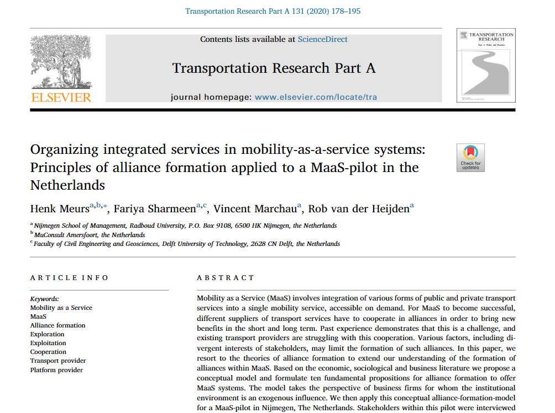

Slide 9
Alliance formation
We conceptualize the nature of cooperation in MaaS as
an alliance of partnering firms offering mobility services
creating value for each partner that cannot be attained
or only at high costs in other ways (e.g. mergers and acquisitions)

Slide 10
Fundamental Questions
Why or why not?
Why (or why not) would a key stakeholder be joining a MaaS alliance?
What preconditions?
What necessary pre-conditions have to be met for a MaaS-alliance to take shape in a certain geo-political context?
Goal?
What would be the goal of such an alliance and how could the governance be arranged?

Slide 11
Key Driver
Why would a transport provider join?
Organizational behaviour analysis
Revenue Drivers
Cost Drivers
Risk Drivers
Long-term Continuity Drivers

Slide 12
Necessary preconditions
Institutional Infrastructure
Legislation and permits
Subsidization
Financing innovation
Availability and standardization of open data

Slide 13
Goal of alliance formation
Exploration Vs Exploitation
exploration goals are important for partners in forming alliances. In later stages exploitation goals become important, such as generating revenues and profits.
POWER OF PARTNERS

Slide 14
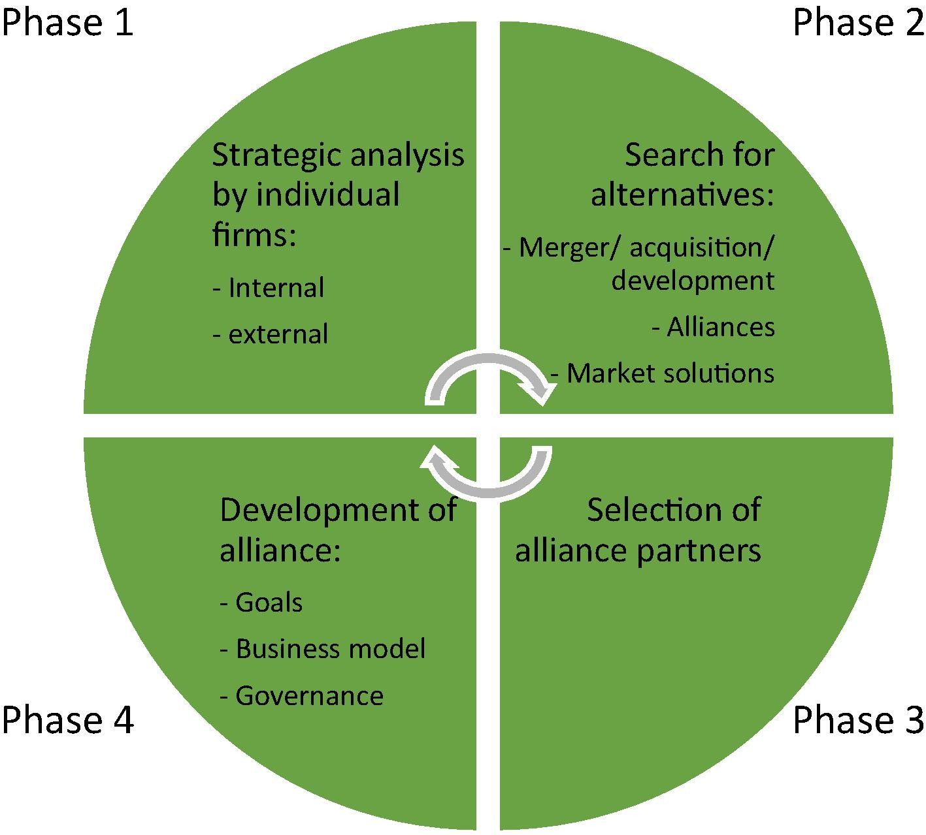
Phases in decision-making : alliance formation

Slide 15
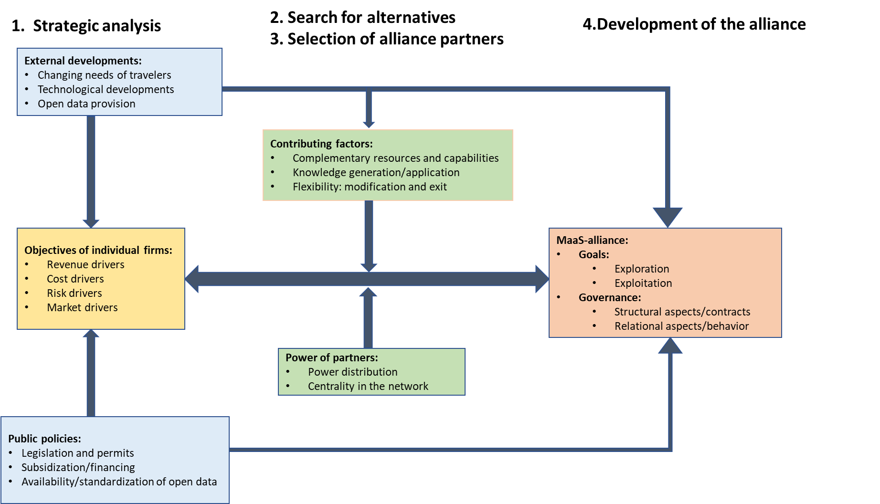
Strategic aspects of business models for MaaS: alliance formation

Slide 16
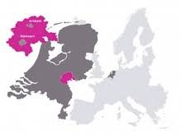

Case Study: Slim Nijmegen
MaaS pilot in NIjmegen
Start up – Go About
Connexxion
September 2018 - 2020
Twin city – Arnhem Nijmegen + Surrounding suburbs and villages
750000 population

Slide 17
Application MaaS in Nijmegen, The Netherlands
Pilot with transport providers
Private MaaS platform
Subsidized by public agencies
Common objective: learn from effects
User groups: university associates
Fares: testing for free
Succesful as a pilot:
  >200 participants
  Relatively well-received
  Changes in mobility in wanted directions

Slide 18
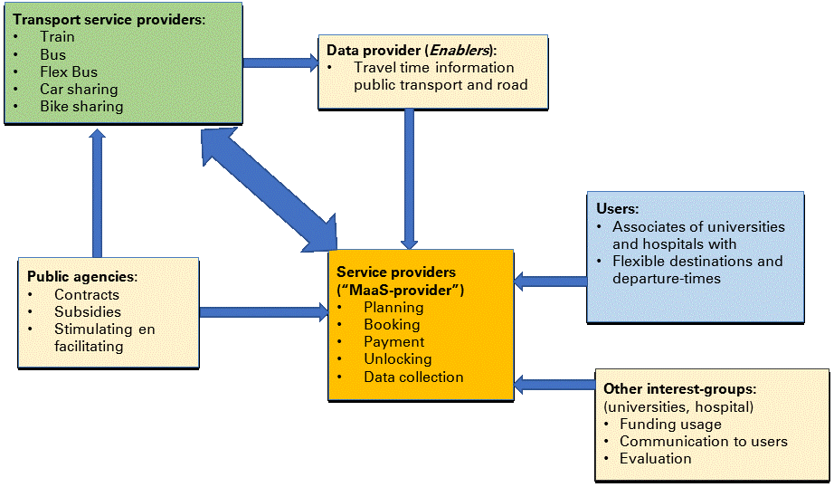
MaaS as an innovation system
Example: Key Stakeholders and their roles with respect to SliM Nijmegen

Slide 19
          Organizational Transition

Slide 20

From Traditional BMs of fixed public transit systems to
Transitioning BMs to flexible or combi PT

Slide 21

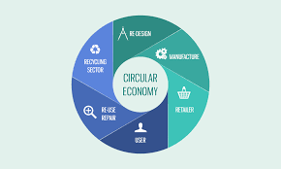

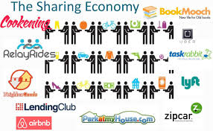
Why flexible and on-demand?

Slide 22


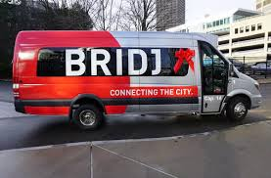
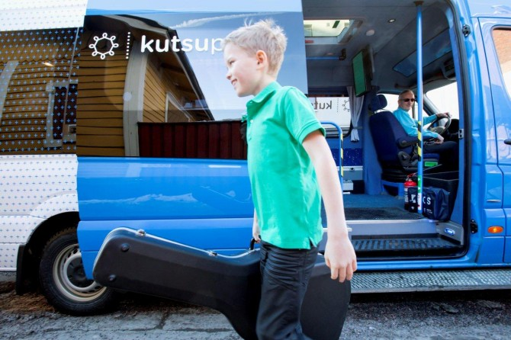

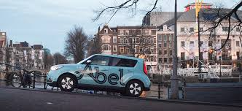
Flexible Public Transit
Service on demand
Appealing to users
Also a promising alternative to transit operators

Slide 23
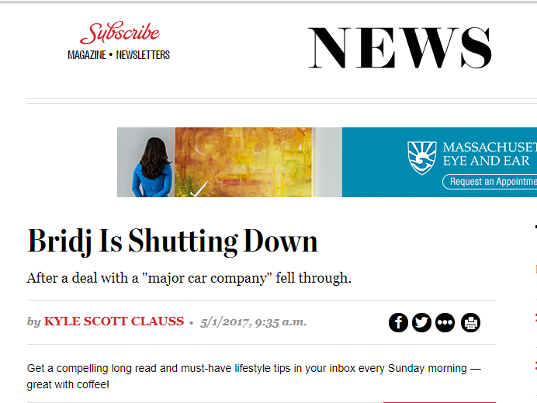
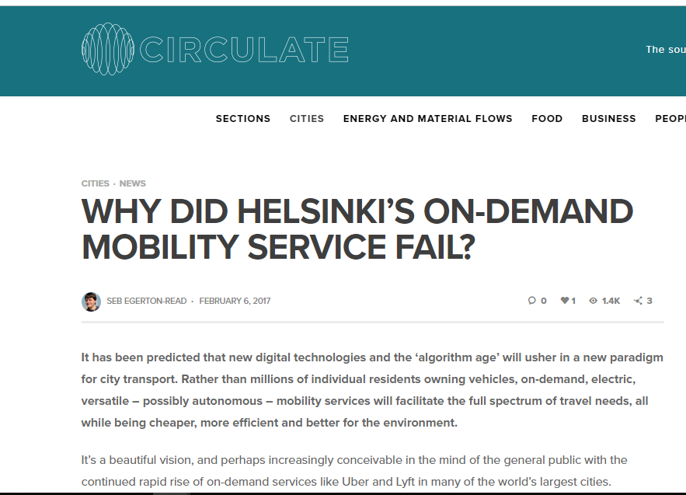
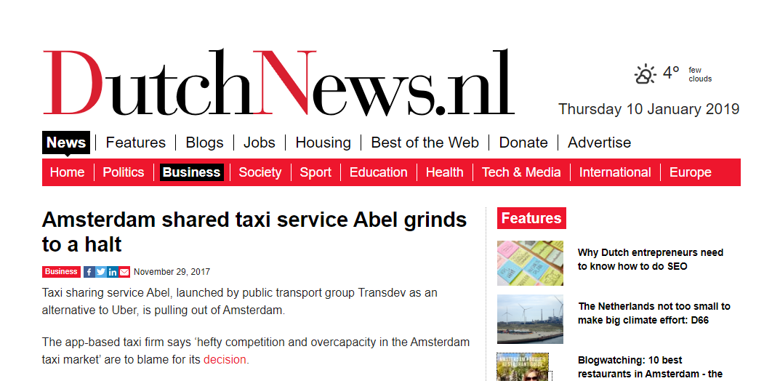
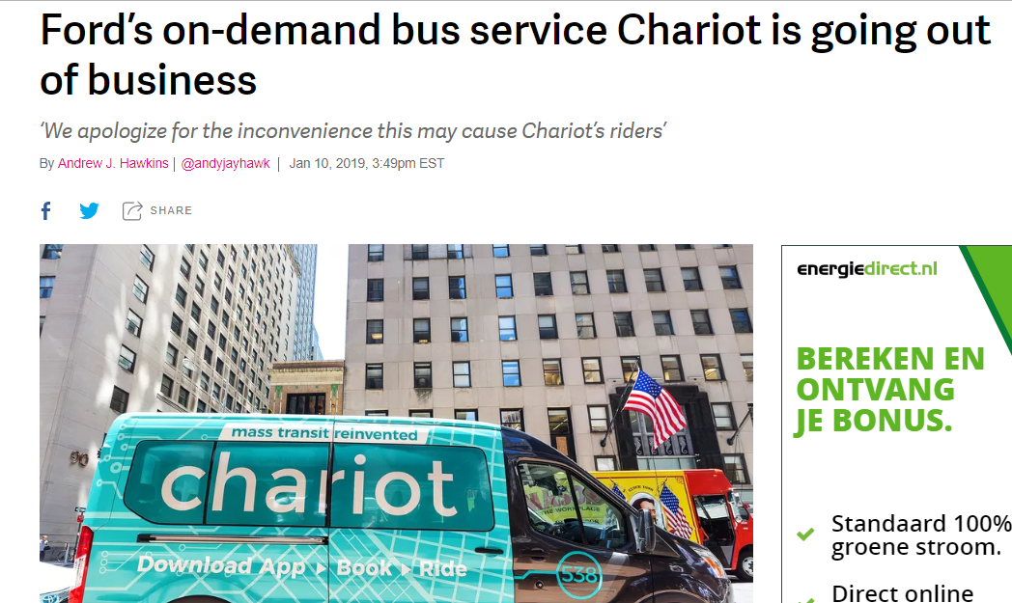
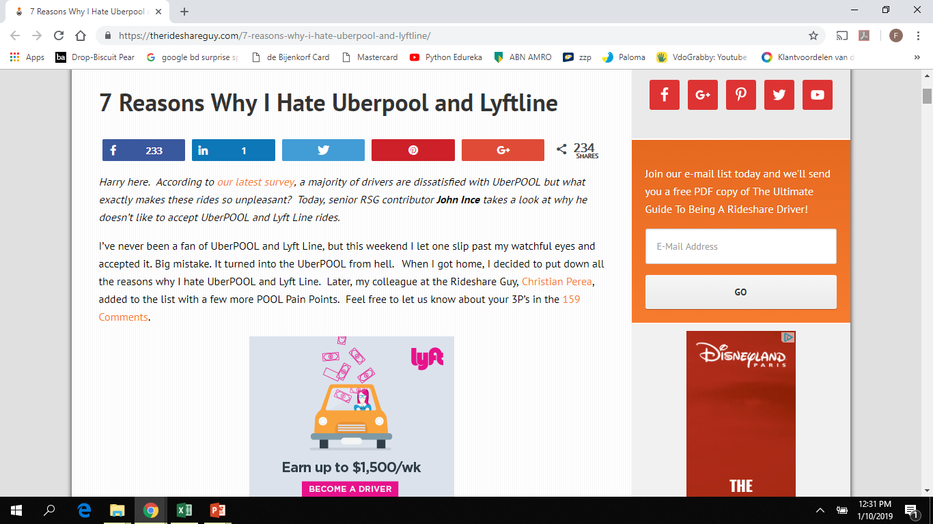
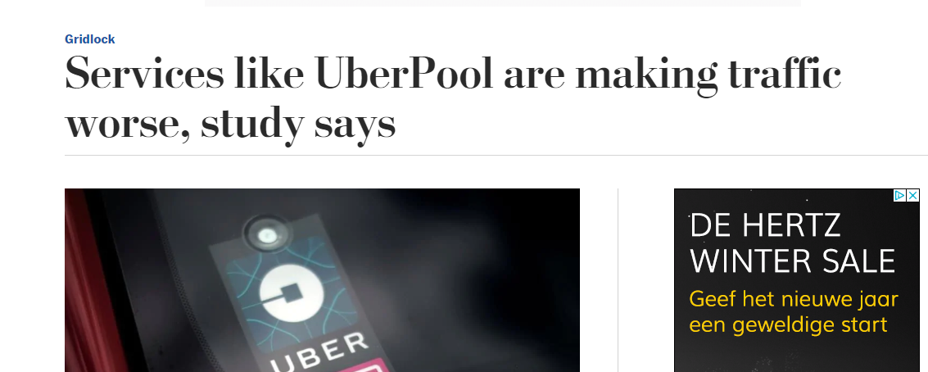

Slide 24
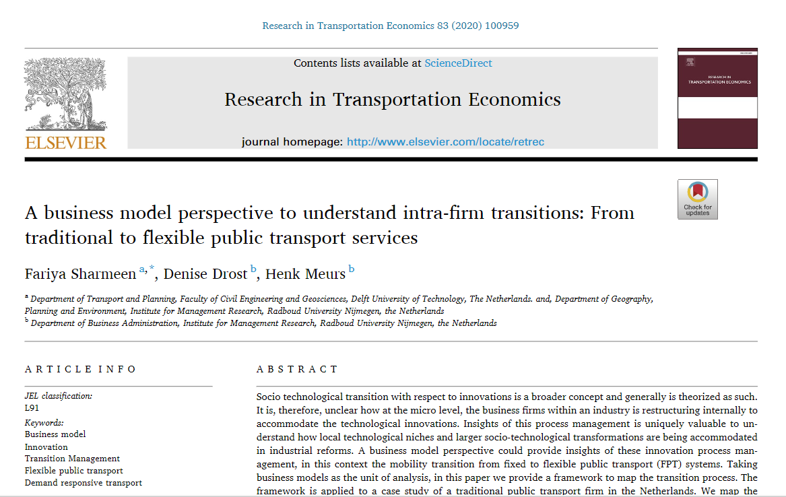
Within firm transition

Slide 25
Role of Businesses and BM’s in innovation
The role of business and business models in innovations :
Barriers to change
Enablers to change
It is an emerging ‘unit of analysis’ that provides a ‘system-level, holistic approach’ (Zott, Amit, & Massa, 2011) to understand the internal transitions to
keep up with technological innovations to remain relevant,
to take advantage of the ‘window of opportunity’ created by socio-political landscape shifts (Geels & Schot, 2007),
to reinvent the firm process management for value creation or
to avert risks posed by external pressures and industrial uncertainties.

Slide 26

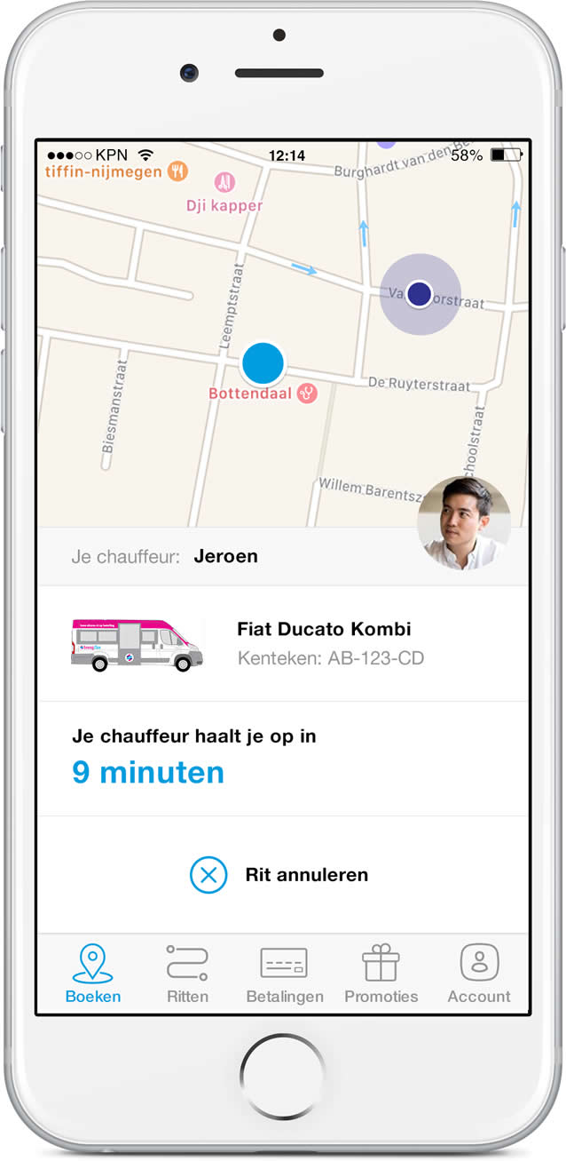
Breng Flex
Flexible DRT
Operated in Arnhem and Nijmegen by Connexxion
Financed by Province of Gelderland
Pilot launch December 2016
Stop to stop
225 stops in the network
Platform based
Fixed rate of € 3.50 per trip
Positive reception and evaluation

Slide 27
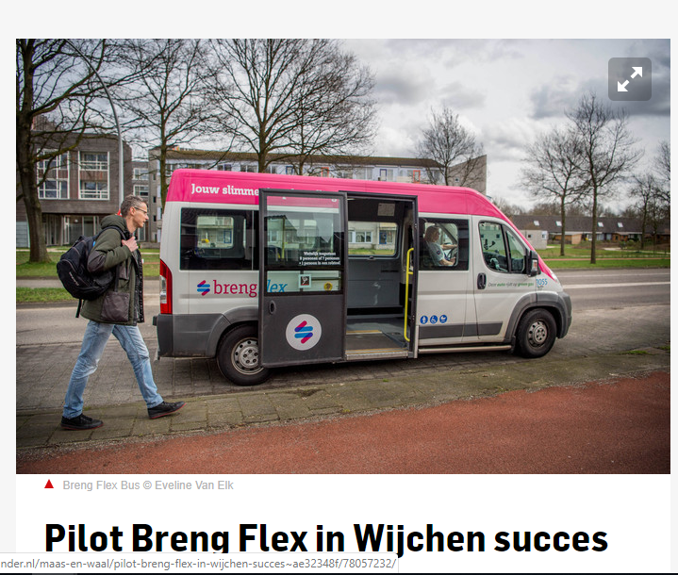
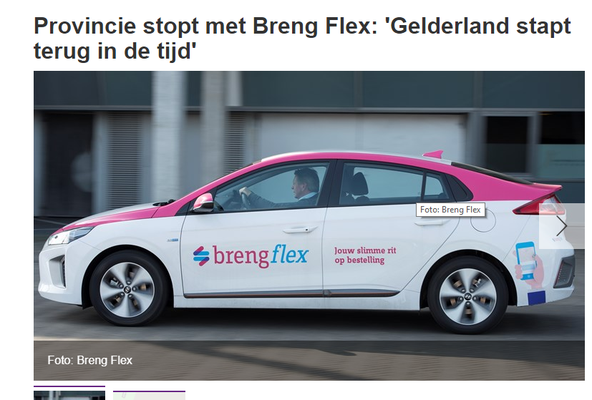
9 October 2017 9 July 2019

Slide 28

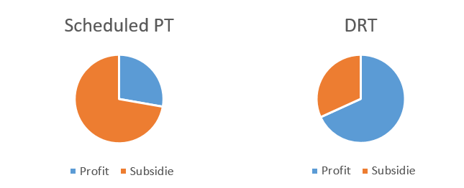


Key findings : Transition of public transport Business Models
Resource allocation and revenue stream
Client orientation
from regional government
to end users
Public governance
Digitalization
Real time update
Online app based
Marketing and distribution

Slide 29
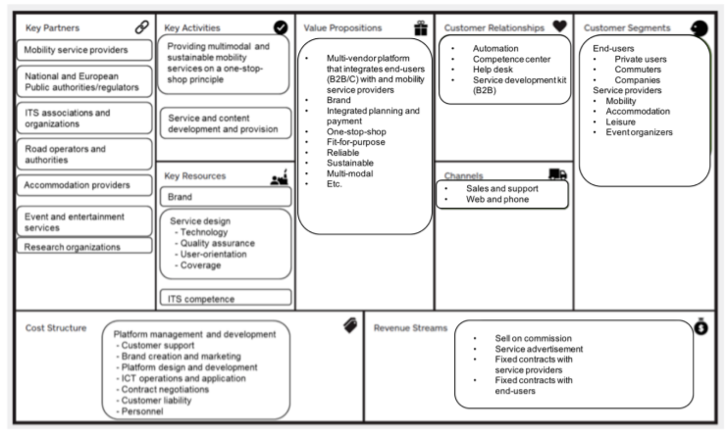
MaaS business model (source, Koenig et al, 2016)

Slide 30
Linking transition theories to sustainable business models
.
C
oncepts
S
ome
c
hallenges
fo
r
businesses
V
alue
proposition
C
ustomer
value of MaaS
A
dditio
nal value
vs current provisio
ns
’
a
ttractive
car
services
S
upply
chain
C
ollaboration
a
mo
ng
B
enefi
ts
for all part
ners involved
partners
C
ust
omer
MaaS
-
provider, platform
API
’
s, i
nteroperab
ility
interface
characteristics
F
inancial
model
P
ay
-
as
-
yo
u go
C
ha
ng
e
current fa
re systems
subscription
S
ubsid
y
arrangements

Slide 31
Barriers in Upscaling MaaS pilot in Nijmegen
Value proposition:
  Difficult to provide desired services under current supply in view of considerable subsidies for public transport
Supply chain
  Long-term tendering contracts provides PT-firm a monopoly
  No car sharing firms wants to participate
Customer interface
  Single vs competing platforms
  Design of app not optimal
Financial model
  Fare system for PT fixed→limiting price discrimination
  Subsidizing PT vs unsubsidized sharing options
External:
  Parking policies do not favor mobility services

Slide 32
Possible pathways
Consumer receives product
Marketplace BM (example, Retail sector - Bol, Amazon)
Consumer receives service
Platform economy BMs (example, Uber, Airbnb)
Consumer receives information
Sharing economy BMs (example, google, 9292)

Slide 33
Relevant Factors
Regulated vs Open competition?
Airline industry model
Governance
  six MaaS governance approaches identified: analyser, architect, convener, experimenter, lawmaker, and provider (Hirschhorn et al., 2019)

Slide 34
          Behavioural Nudging

Slide 35
Paradigm Shift in Bicycle: Use, Investment and Research
Use for intra-city movements and as a feeder mode to transit
‘High speed’ cycling as an alternative to car for commuting
  Unobstructed infrastructure
  Cycling Innovation
  Continued policy commitment
  Systematic research in cycling

Slide 36

Cycling Innovations
https://bicification-project.eu/
Reward based gamification system
Ride and Earn
1500 users in Braga, Istanbul and Tallinn
Finalist of Smart City Expo Awards
Notes:
Such initiatives, however, often is seen outside of the mainstream transportation planning. Even in a country like Netherlands, bicycle-friendly policies often depend on the activities of the so-called policy entrepreneurs. The recent interest for cycling in the Netherlands and the rapid increase in bicycle use in many cities around the world can in part be attributed to a new generation of active inventive forms of ‘policy entrepreneurship’.
Policy entrepreneurs are highly motivated individuals who strategically seek to gain attention for specific policy issues, aiming to promote such on the governmental agenda, and ultimately pushing for adoption of measures and policies.

Slide 37
Policy Matters
Policies matter
Investments generate a larger impact
Push and Pull
Five main requirements for a good bicycle network: coherence, directness, attractiveness, safety, and comfort
Involvement of citizens and interest groups
Travel time is important
A clear preference for undisturbed and convenient cycling conditions

