Slide 1



HOW TO GET PEOPLE ENGAGED?
Prof. Cathy Macharis
Vrije Universiteit Brussel

Slide 2


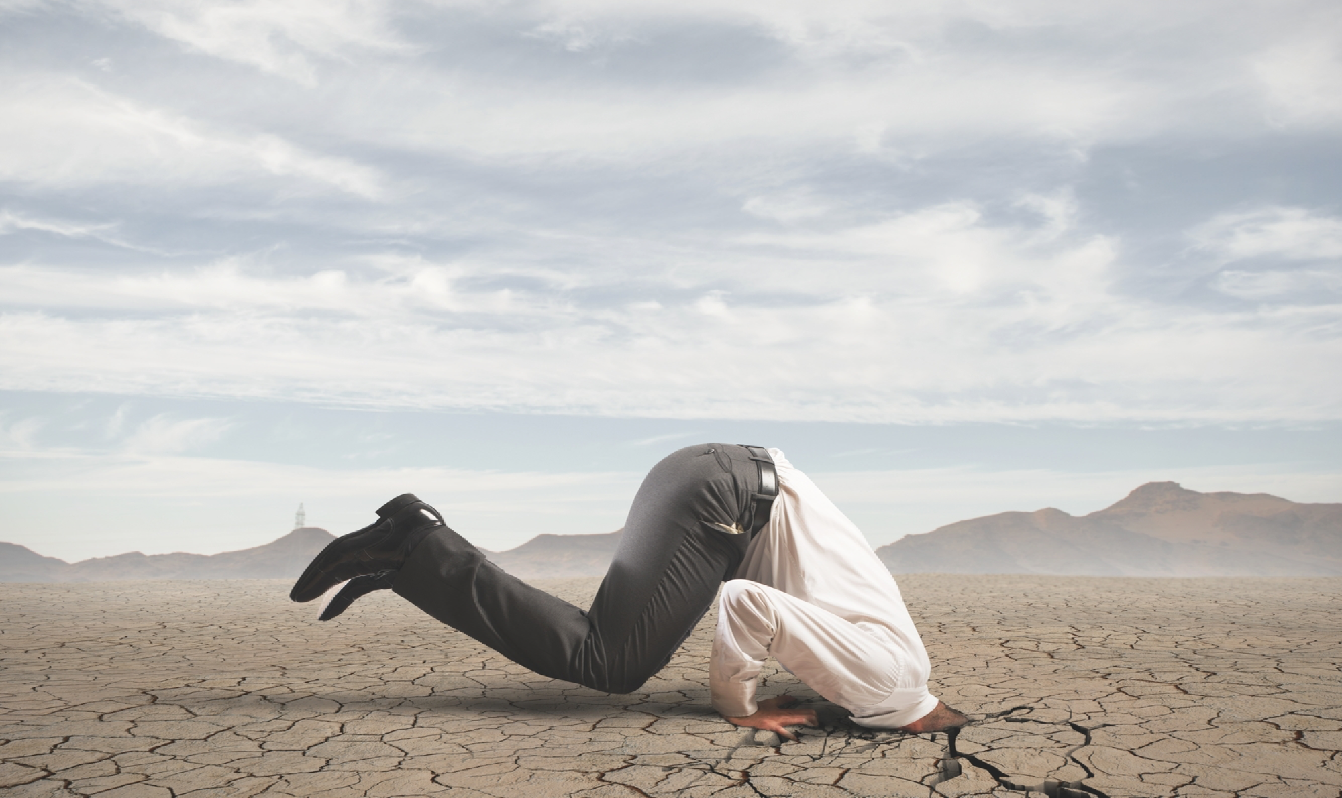
How to change behaviour?

Slide 3


Technology?

Slide 4


INTERACTIVE WORKSHOP USING THE G-WAVE METHOD
GOAL: think about a new goal you want to achieve after this course
WHY: why would you pursue this goal?
ACTIONS: list the actions to be taken to achieve your goal
VISUALIZATION: visualize the actions listed in the previous step to further refine how to prepare for the new behavior
ENGAGE: engage resources to achieve your new goal

Slide 5

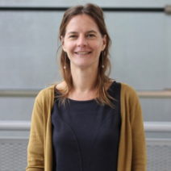
Thank you! Questions?
Prof. dr. Cathy Macharis
E-MAIL:
Cathy.Macharis@vub.be
PHONE:
+32 2 614 83 03
ADDRESS:
Pleinlaan 2, 1000 Brussels
OFFICE:
Building PL5, 4.37

