Slide 1



Avoidance
Avoiding transport through proximity: an urban planning perspective
Urban Mobility Bootcamp
prof. dr. Kobe Boussauw
22 November 2022

Slide 2

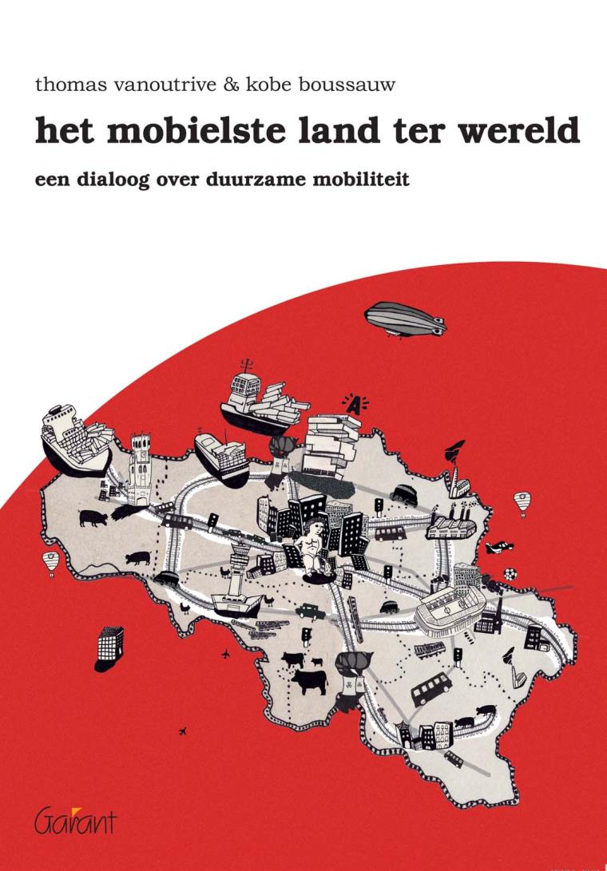
'avoidance' in the 'factor 8' spectrum
distance working
ridesharing
efficient logistics
urban planning

Slide 3

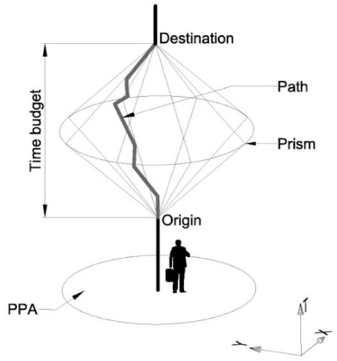
mobility -> accessibility
  mobility:
  the total amount of kilometres travelled in a system (per person, per ton, per car, ...)
  correlated with external effects (environment, congestion, accidents, quality of life, ...)
  worth pursuing?
  accessibility:
  the opportunities for interaction of an individual in relation to the range of destinations that are potentially of interest to him/her
  worth pursuing?

Slide 4
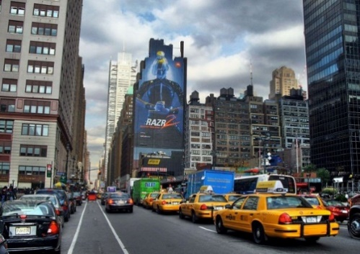
accessibility -> proximity
  accessibility can be decomposed into:
  speed
  proximity
  the built environment determines conditions of accessibility:
  spatial distribution and mutual proximity of homes, jobs, amenities
  infrastructure including parking facilities and design aspects of the public realm

Slide 5
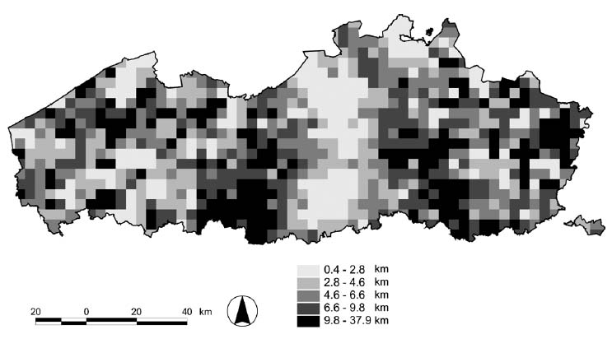
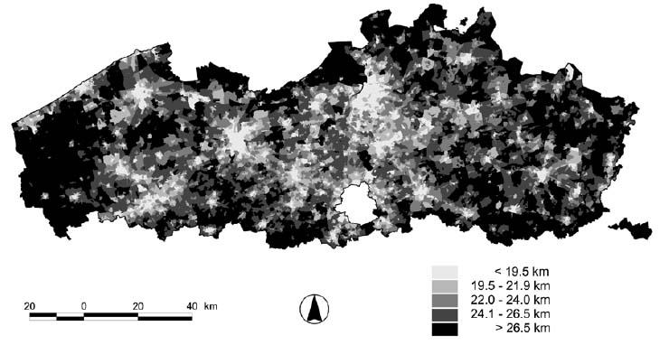
how does proximity look like?
'minimum amenity travel by household'
'minimum commuting distance'

Slide 6
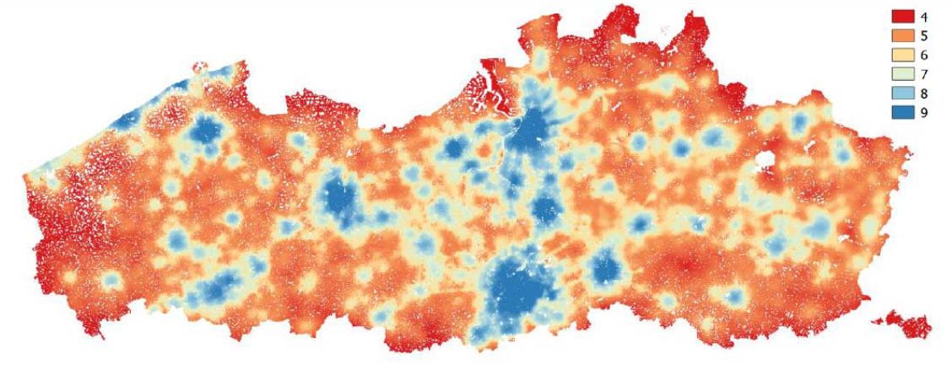
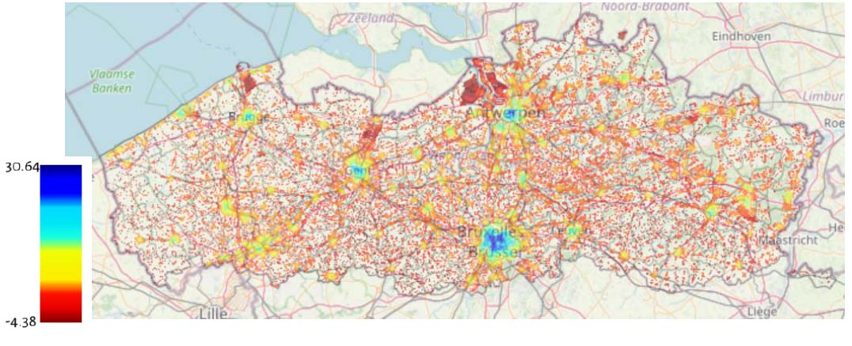
how does proximity look like?
'walkability index'
'mobiscore'

Slide 7
Translating proximity into urban planning: the three Ds
borrowed from Cervero and Kockelman (1997)
result of research into:
  aspects of the built environment
  can be influenced by policy
  with a measurable impact on the sustainability of travel patterns (distance and travel mode)
threefold framework:
  density (mainly in terms of population density)
  diversity (degree to which functions are spatially mixed)
  design (design of neighbourhoods and public spaces, in terms of attractiveness for ‘soft’ road users, liveability, and separation of traffic flows)

Slide 8
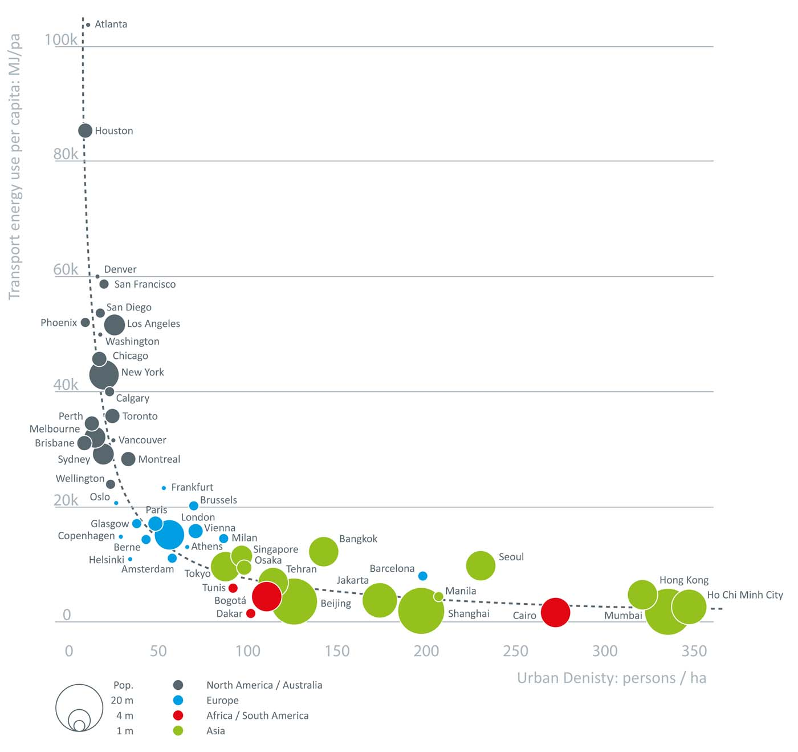
Density: theory
at the macro level (Newman & Kenworthy, 1989):
  density ~ fuel consumption⁻¹
  density ~ public transport use
  supply of road and parking infrastructure ~ car use
  level of congestion ~ travel time⁻¹, car use⁻¹
  cost of public transport ~ car use
  relationship between car use / fuel consumption and general prosperity not unequivocal (exceptions do exist, e.g. Tokyo)

Slide 9
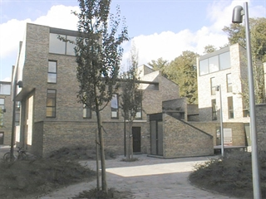
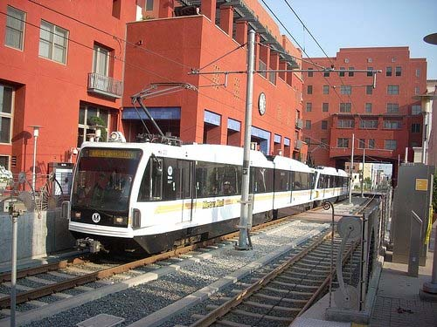
Density: practice
high residential density:
  can lead to shorter travel distances, more public transport and bicycle use, and more support for the development of high-performance public transport
  effects are particularly noticeable at the macro level, intervention is often difficult and expensive, effects often are rather small
  where is compaction of the residential environment important:
    adjacent to pre-existing dense urban fabric
    near amenities, typical in urban sub-centres, town and village centres
    near stops/stations of high-quality public transport
  density often also favourable for other reasons
  high density: > 120 inh/ha (literature eco-neighbourhoods) cfr. > 25 dwellings/ha (Spatial Structure Plan for Flanders)

Slide 10
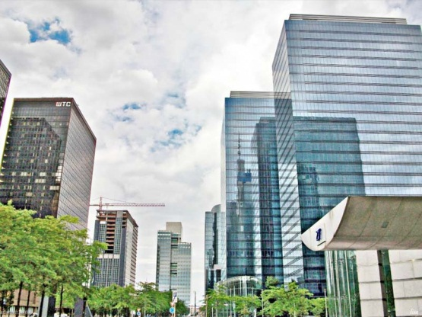
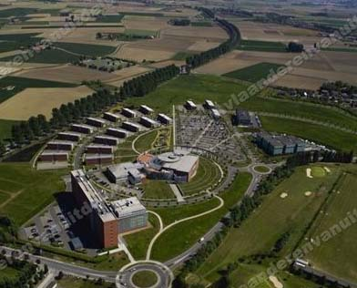
Density: practice
high density workplace locations:
  can lead to more public transport use and more support for the development of high-performance public transport
  can however lead as well to excessive commuter mobility (e.g. Brussels North quarter), even if it is by train (larger distances in home-work travel)
  high concentration of activities can lead to exceeding environmental standards (e.g. air quality: particulate matter)
  when is compaction of workplace locations absolutely important?
    near well-connected railway stations (existing station precincts, but also attached to new rail networks (metro, light rail)) (TOD)
    office locations for highly specialized workers

Slide 11
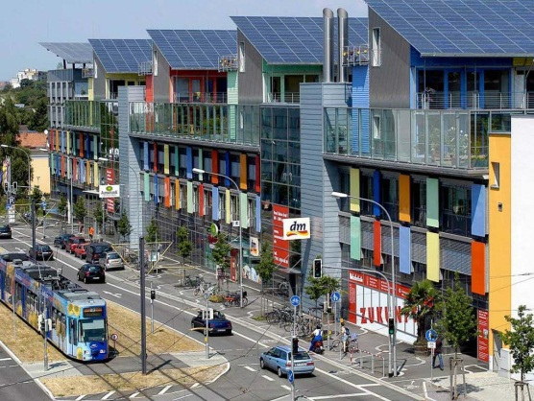
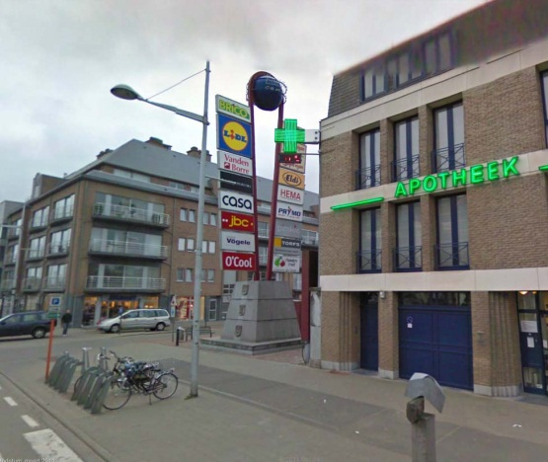
Diversity: theory
better spatial mix of diverse functions:
  can lead to shorter distances, more cyclists and pedestrians, but:
  often not easy to mix work places and housing (e.g. manufacturing, environmental standards, highly specialized jobs)
  people tend to compensate for a wider range of potential destinations through more complex travel patterns (instead of shorter trips)

Slide 12
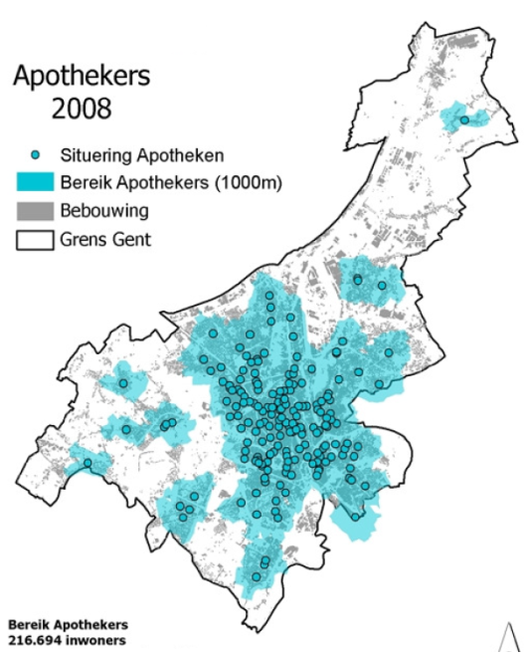
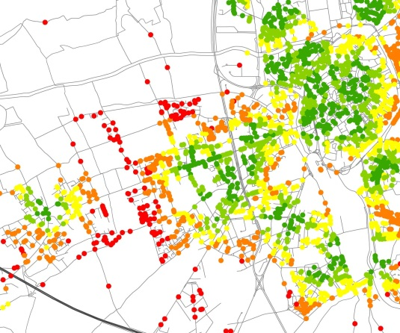
Diversity: practice
supply of local amenities:
  avoid mono-functional allotment development
  planning for a dense network of kindergartens, nursery and primary schools and other public facilities
  facilitating local retail facilities (grocery store, bank branch office, bakery store, ...)
  organizing small-scale shopping centres embedded in the fabric of the city or village
  development of sub-centres (also railway station precincts)
  regulation of amenities’ location choice:
  large-scale shopping centres and ribbons of retail warehouses
  public facilities upscaling or moving out of the centre of the village of the city (e.g. schools)

Slide 13
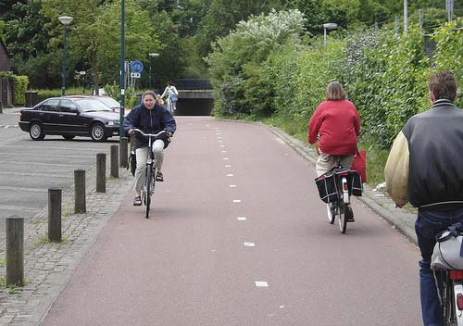
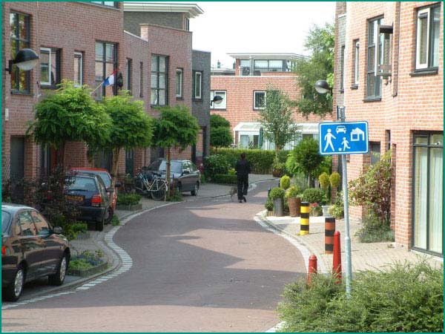
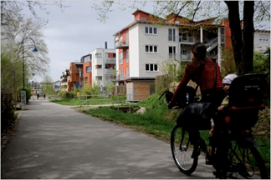
Design: theory and practice
design of neighbourhoods and public space can lead to larger share of sustainable trips:
  cut streets for cars, through traffic reserved for cyclists and pedestrians (e.g. in Houten, NL)
  circulation plans with loop systems
  spacious, safe and attractive bicycle and pedestrian infrastructure (including cycling highways)
  organized bicycle parking (also in buildings)
  traffic-inhibiting street design
  safe and efficient crossing facilities
  limit the occupation of public space by car infrastructure
  organized parking; edge parkings outside residential blocks
  attractive train stations and public transport stops
  pedestrianized streets
  low-traffic residential areas (‘woonerven’)

Slide 14
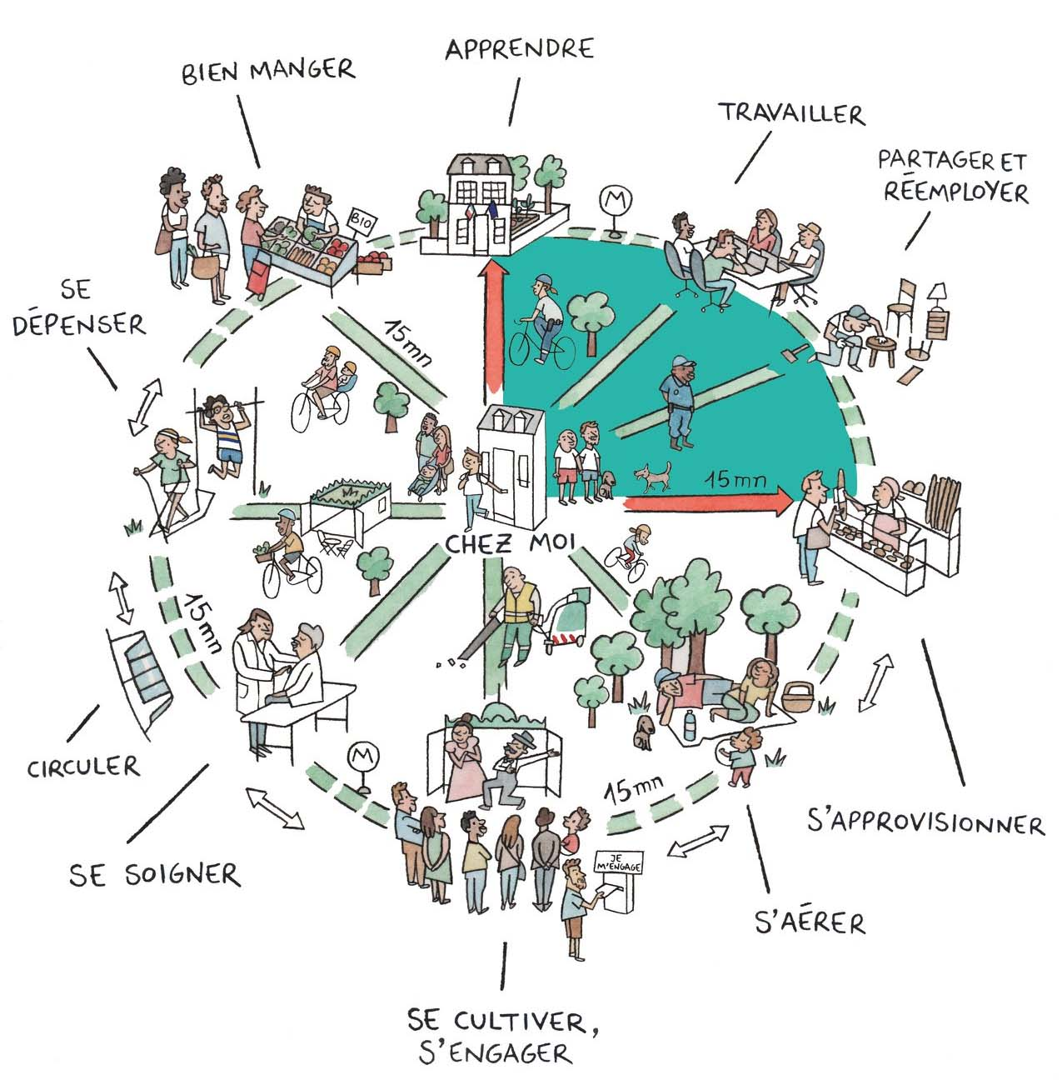
to conclude: The 15-minute city as a contemporary approach to proximity planning
'new' leading planning principle in recent urban or spatial policy plans
general concept: intertwine daily destinations as closely as possible with the residential fabric, accessible within 15 minutes of walking, cycling, or travelling on public transport
supported by the pandemic lockdowns that forced citizens to rediscover their nearby living environment
includes social equity and sustainability goals, has still provoked a number of criticisms

