Slide 1
Welcome.
What is the Urban Mobility Changemaker?

Slide 2
Urban Mobility Changemaker 2021-2022
Mikko Laak
Urban Mobility Changemaker Bootcamp
November 22-23, 2022
Brussels & online

Slide 3

We seek to empower urban mobility professionals for a transition towards sustainable urban mobility

Slide 4





Urban Mobility Changemaker
The Urban Mobility Changemaker program is an event series consisting of workshops, a bootcamp, an online course, and a podcast for urban mobility and transport planning students and professionals.

Slide 5
Urban Mobility Changemaker
The events offer theory and hands-on content for urban mobility executives and professionals, as well as specialists, researchers, decision-makers, planning officials, and representatives from NGOs, local authorities, and policy groups.

Slide 6
Urban Mobility Changemaker
Core contents of this professional development program lie in understanding and facilitating organizational change and developing a collective understanding for (retro-) fitting public authorities and private actors to facilitate sustainable future mobility in different societal and geographic contexts.

Slide 7
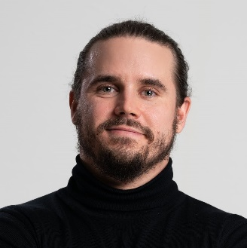
Aalto University Executive Education
Mikko Laak
Senior Program Manager
Aalto University Executive Education

Slide 8




Aalto University Executive Education Ltd
UNIQUE PORTFOLIO OF EXECUTIVE EDUCATION AND PROFESSIONAL DEVELOPMENT
We are first and foremost driven by
the impact we can have through
our programs – on participants,
their organizations, the academic
community, and society at large.
Among the top 50
executive education
providers worldwide
(Financial Times Executive Education Ranking)
Aalto EE for management and leaders
Aalto University Executive Education Ltd
is fully owned by Aalto University. Our
operations provide a sizeable income to the
university community in various forms such
as dividends, lecture fees, and rents. In 2020, our financial footprint in the Aalto community
amounted to approximately EUR 2.3 million.
Aalto PRO for variety of experts
Aalto ENT for entrepreneurs and
developing intrapreneurship
Finva for finance and risk management
expertize
Around 7,000
participants from
1,000 organizations yearly
Two strongholds:
Helsinki and Singapore
Turnover 17.6
MEUR (2020)
Operating globally in
multiple locations
Aalto ACCESS for everyone interested in
lifewide learning

Slide 9
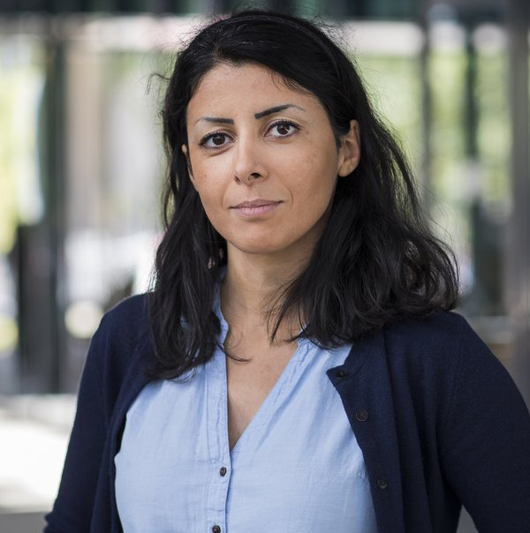
TU Eindhoven
Soora Rasouli
Professor, Chair of Urban Planning and Transportation Group
Eindhoven University of Technology

Slide 10
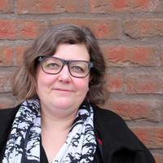
KTH Stockholm
Maria Håkansson
Associate Professor, Head of Department, Urban and Regional Studies
KTH Royal Institute of Technology

Slide 11
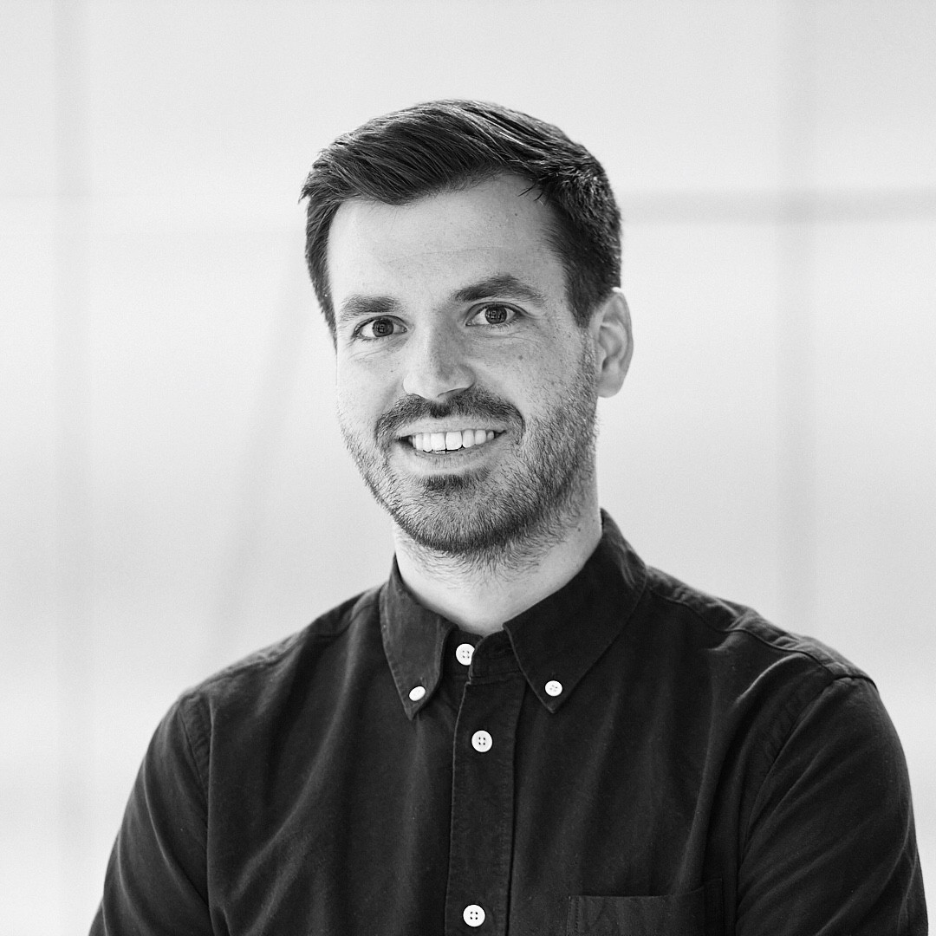
Digital Hub Mobility by UnternehmerTUM
Maximilian Ritz
Senior Service Designer
Digital Hub Mobility by UnternehmerTUM

Slide 12
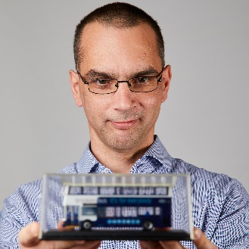
Mobilise
Prof. Dr. Imre Keseru
Assistant professor and team leader, Mobilise
Vrije Universiteit Brussel (VUB)

Slide 13
Activity outline and goals

Slide 14
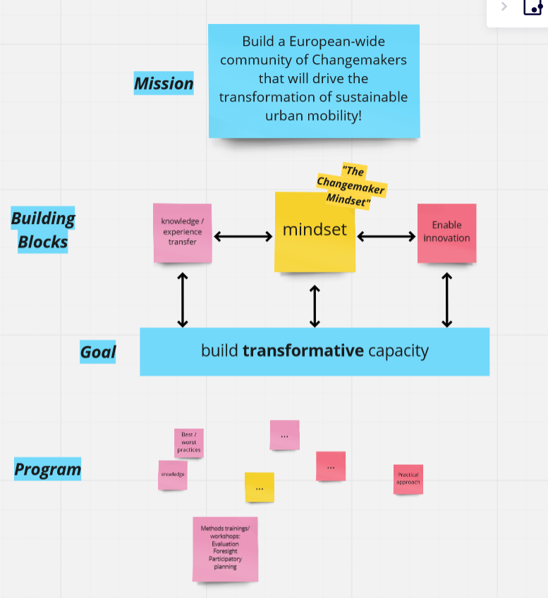

Slide 15
Main Objective
Build an international Changemaker community
Educate Urban Mobility professionals, academics, decision makers and students to be Changemakers
Create sustainable change
Build solid ground for Urban Mobility Innovations
Series of events and workshops
Online material
  Online course by
  Online workshops
  Urban Mobility Changemakers Podcast

Slide 16
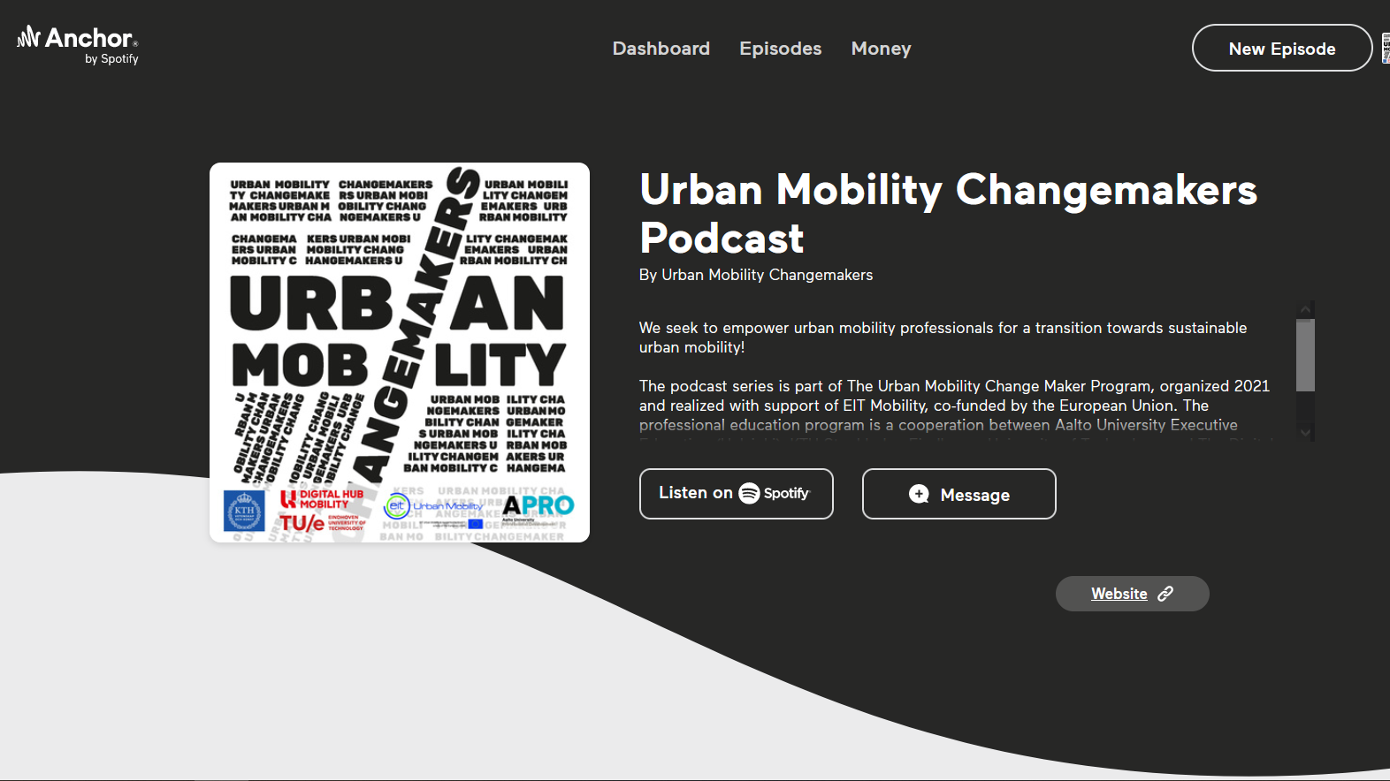

Slide 17
https://mobility.unternehmertum.de/urban-mobility-changemaker

Slide 18

https://mobility.unternehmertum.de/urban-mobility-changemaker

Slide 19
The transition towards zero emission mobility
Awareness
Avoidance
Act & Shift
Anticipation of new technologies
Acceleration
Actor involvement
Adaptation
All in love

Slide 20
“
We are looking forward to exciting keynotes, inspiring discussions and networking with all the Changemakers present online and on site!

Slide 21
Mikko Laak
Senior Program Manager
Aalto University Executive Education
Helsinki, Finland
mikko.laak@aaltoee.fi
+358 50 458 9500

